Slide 1
The open way of Japanese culture
The open way of Japanese culture
Reflections about the outstanding , universal value of Japanese culture and the contribution of Christianity
Msgr Francesco FOLLO
Nagasaki , 7th November 2014

Slide 2
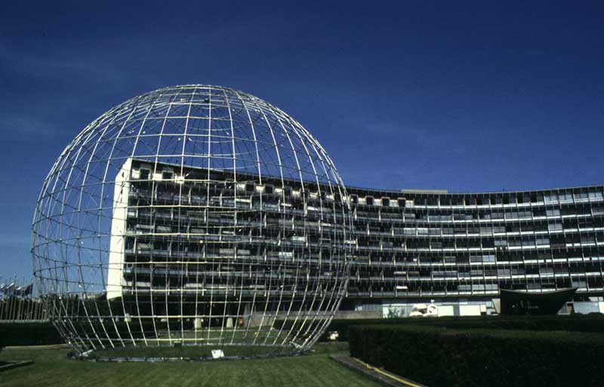
The open way of Japanese culture
The open way of Japanese culture
UNESCO Headquarters - Paris

Slide 3
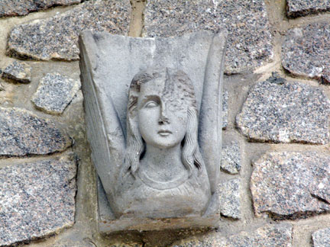
The open way of Japanese culture
The open way of Japanese culture
Angel of the Nagasaki Cathedral at UNESCO - Paris

Slide 4
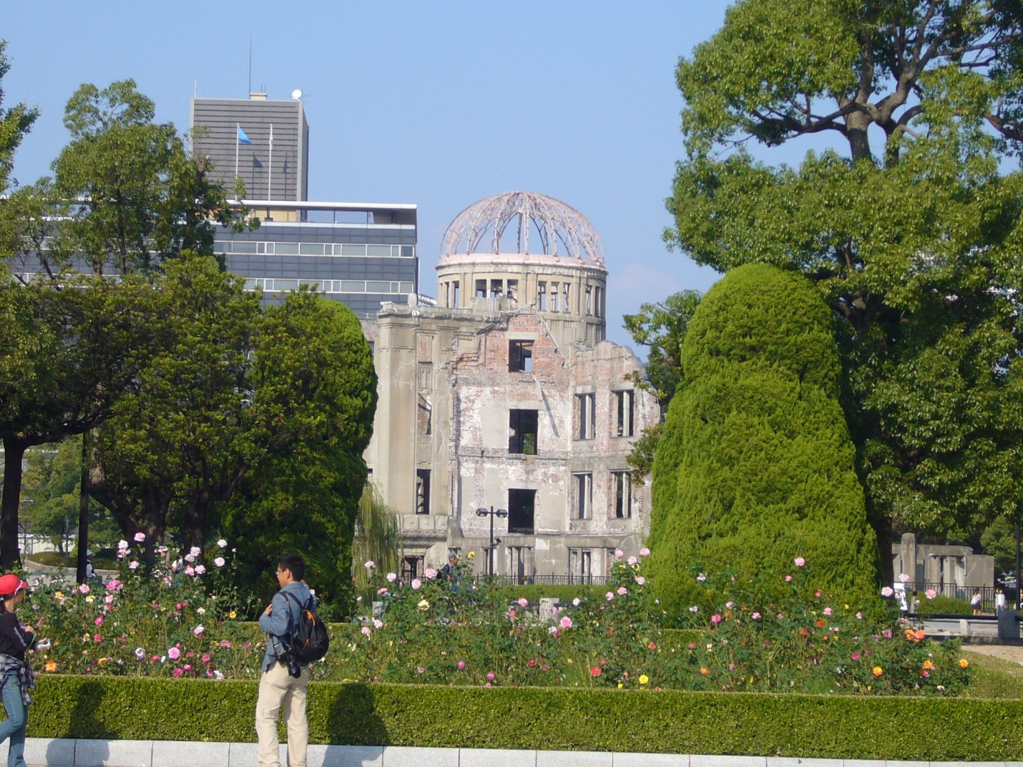
The open way of Japanese culture
The open way of Japanese culture
Peace Memorial - Hiroshima

Slide 5
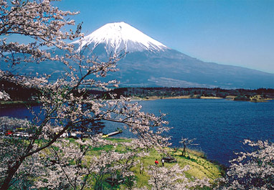
The open way of Japanese culture
The open way of Japanese culture
Fujisan – Natural Heritage

Slide 6
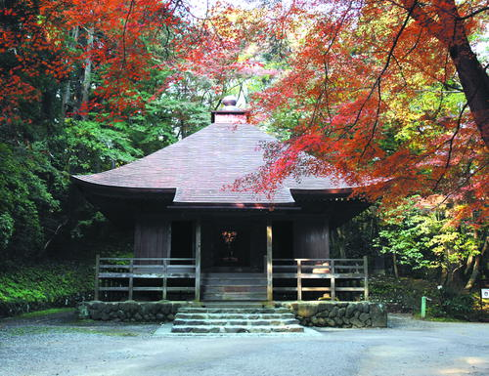
The open way of Japanese culture
The open way of Japanese culture
Hiraizumi - Temples, Gardens and
Archaeological Sites - Tangible Heritage

Slide 7
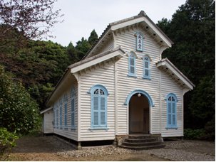
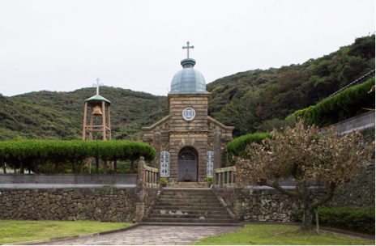
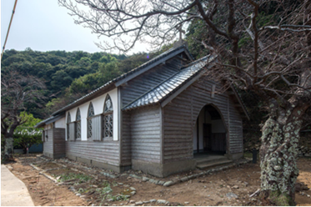
The open way of Japanese culture
The open way of Japanese culture
Egami church
Kashiragashima
church
Churches in Nagasaki - Examples of new sites to be classified
Shitsu church
Kuroshima church

Slide 8
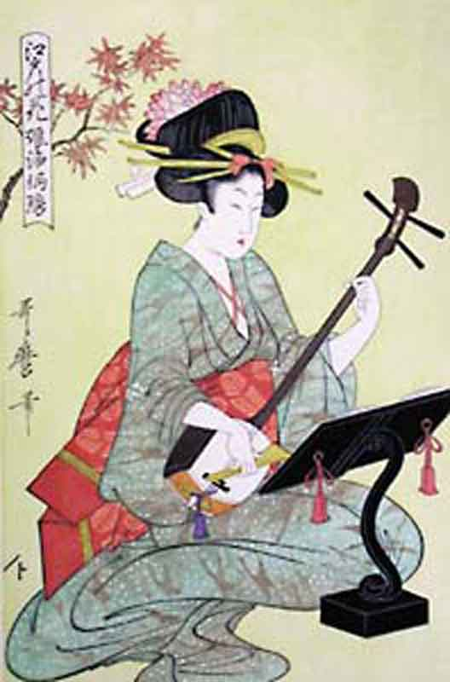
The open way of Japanese culture
The open way of Japanese culture
Music - Intangible Heritage

Slide 9
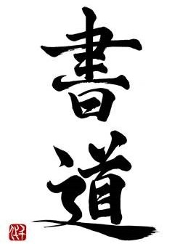
The open way of Japanese culture
The open way of Japanese culture
Calligraphy - Intangible Heritage

Slide 10
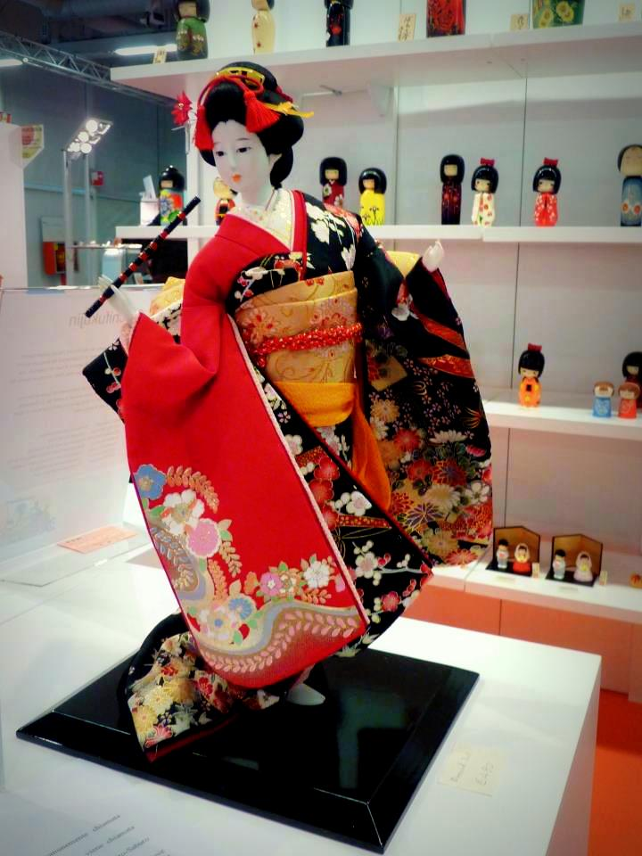
The open way of Japanese culture
The open way of Japanese culture
Handicraft - Intangible Heritage

Slide 11
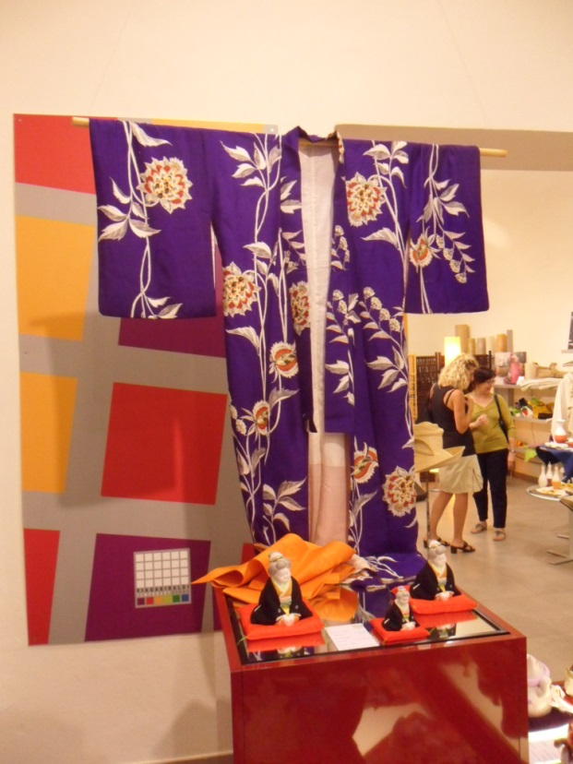
The open way of Japanese culture
The open way of Japanese culture
Handicraft - Intangible Heritage

Slide 12
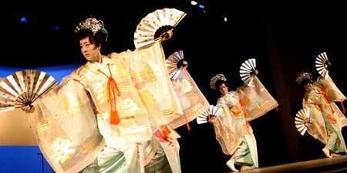
The open way of Japanese culture
The open way of Japanese culture
Dance - Intangible Heritage

Slide 13
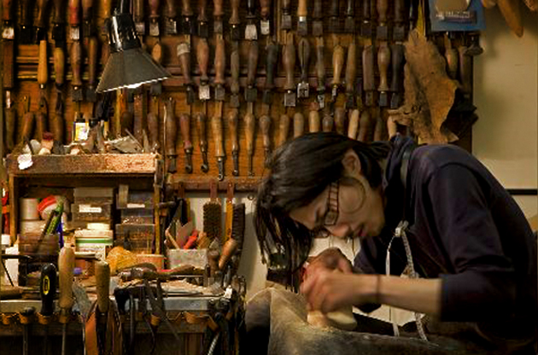
The open way of Japanese culture
The open way of Japanese culture
Craftsman at work – Intangible Heritage

Slide 14
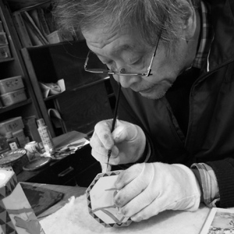
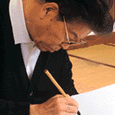
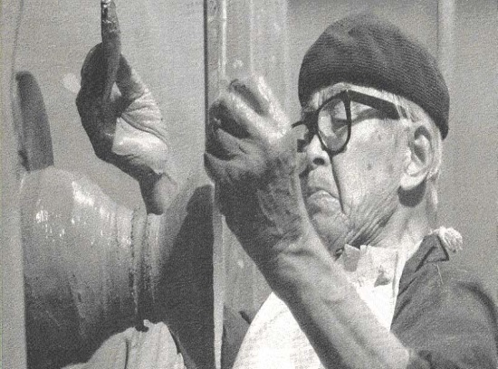
The open way of Japanese culture
The open way of Japanese culture
Takahashi Makoto Tokio Hata Miwa-Kyusetsu XI
National Treasures of Japan - Intangible Heritage

Slide 15
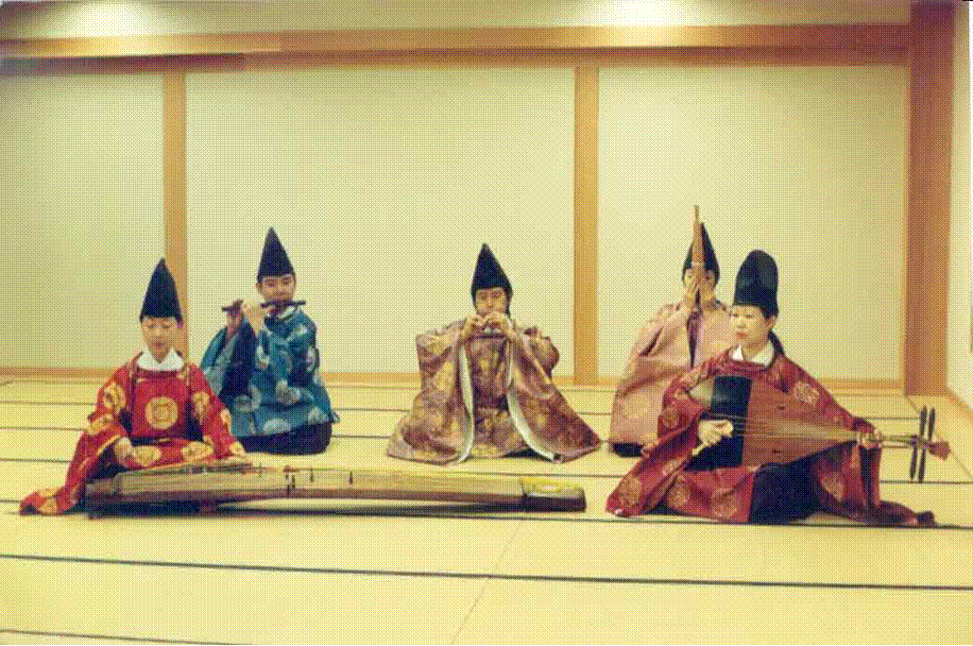
The open way of Japanese culture
The open way of Japanese culture
Music - Intangible Heritage

Slide 16
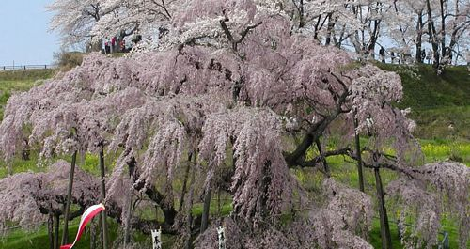
The open way of Japanese culture
The open way of Japanese culture
Intangible Heritage of religious interest

Slide 17
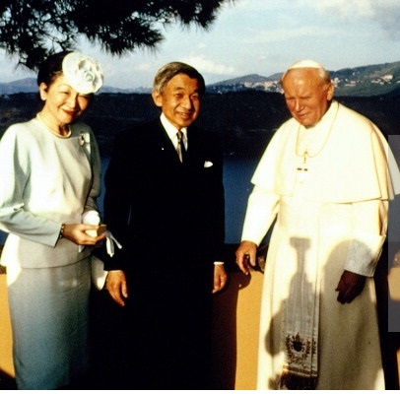
The open way of Japanese culture
The open way of Japanese culture
Request of the Holy See to recognize the religious aspects in the life of people

Slide 18
The open way of Japanese culture
The open way of Japanese culture
Japanese Culture
as
space of freedom
offered to the world

Slide 19
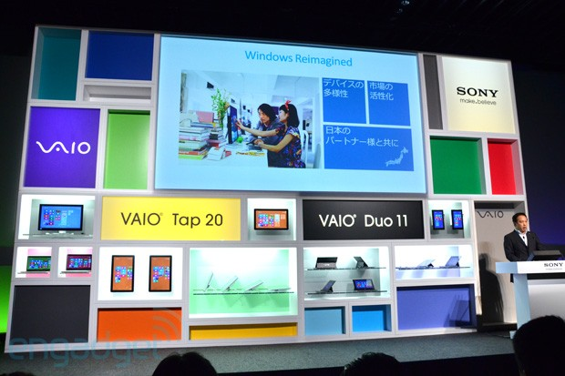
The open way of Japanese culture
The open way of Japanese culture
Freedom and Technology - Example

Slide 20
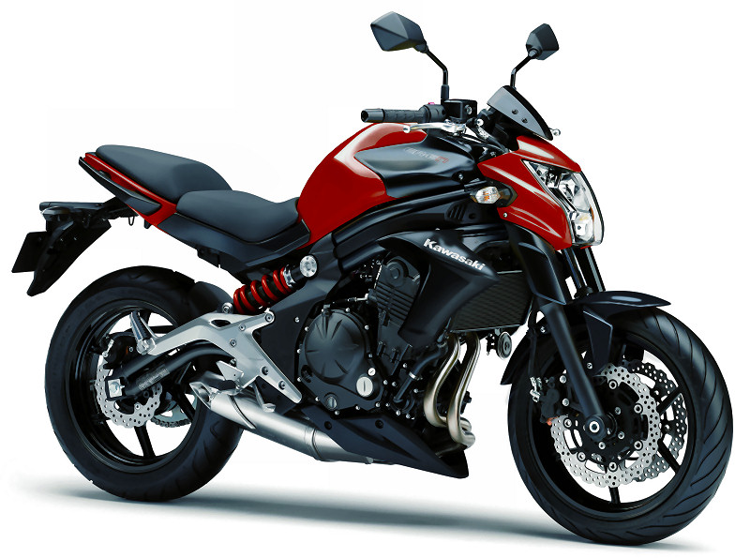
The open way of Japanese culture
The open way of Japanese culture

Slide 21
The open way of Japanese culture
The open way of Japanese culture
Freedom and Politics
Freedom and Faith

Slide 22
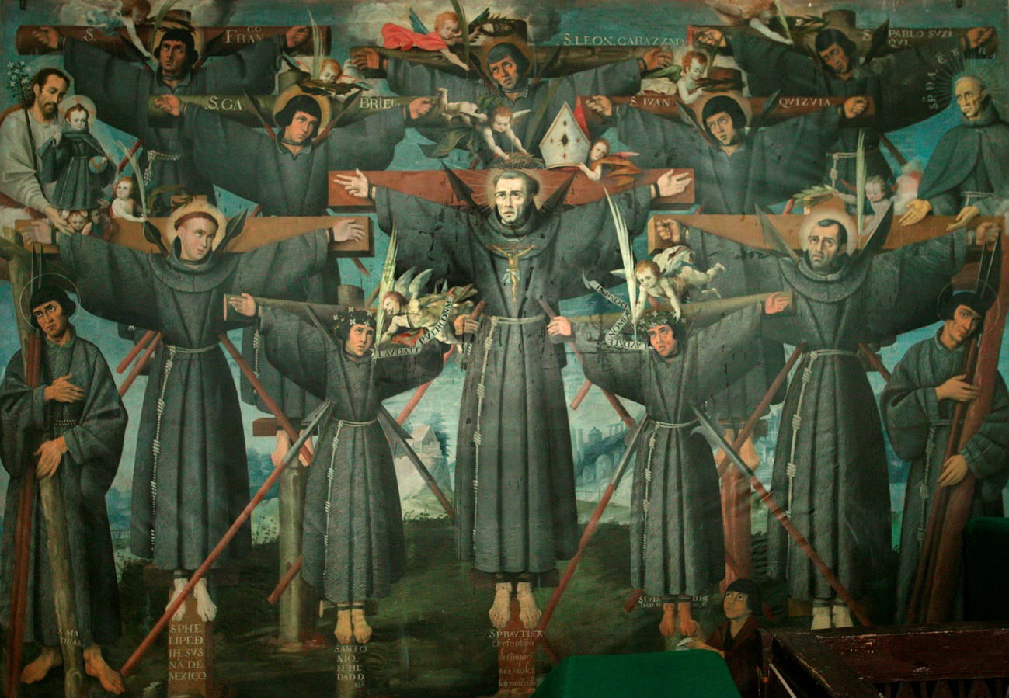
The open way of Japanese culture
The open way of Japanese culture
Martyrs of Nagasaki

Slide 23
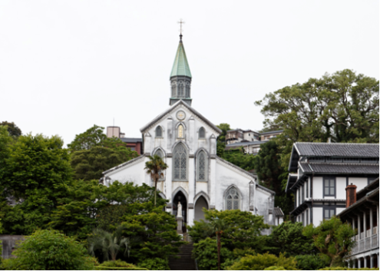
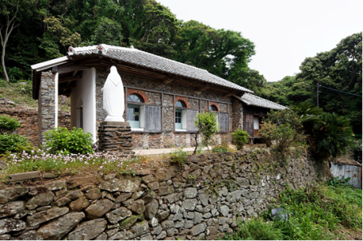
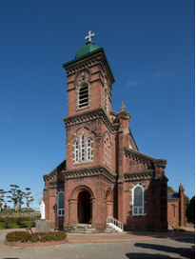
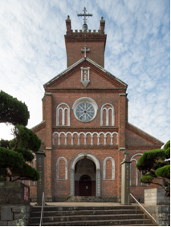
The open way of Japanese culture
The open way of Japanese culture
Churches in Nagasaki
to be classified -
Tangible Heritage
Oura Cathedral
Tabira Church
Ono Church
Former Gorin Church

Slide 24
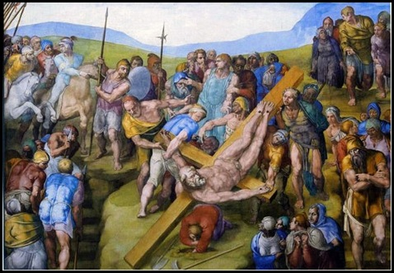
The open way of Japanese culture
The open way of Japanese culture
Saint Peter Martyr - Rome

Slide 25
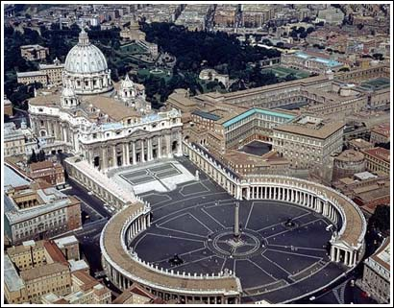
The open way of Japanese culture
The open way of Japanese culture
Vatican City – World Heritage

